Slide 1
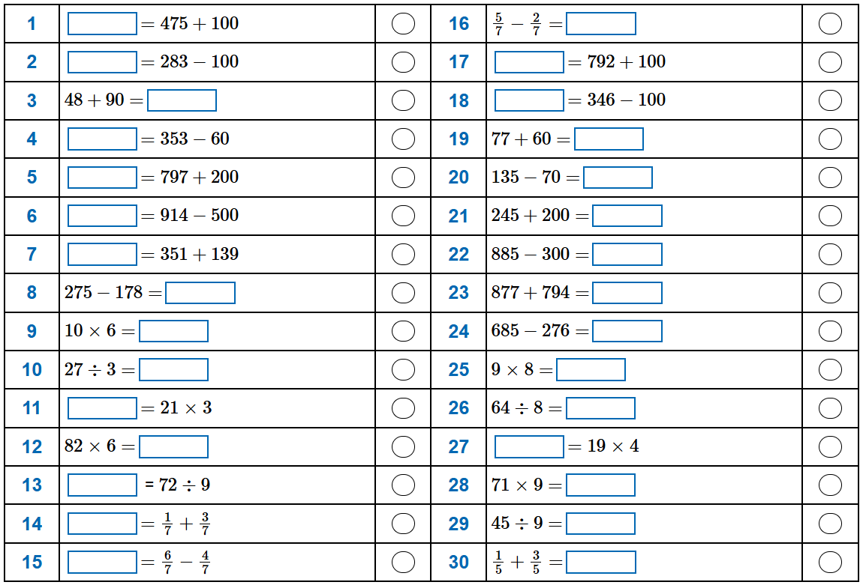
Arithmetic Day 1

Slide 2
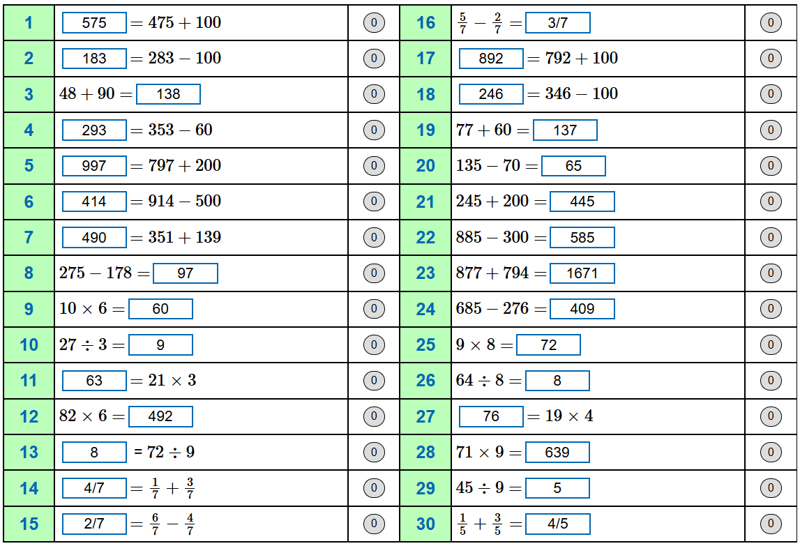
Arithmetic Day 1 – Answers

