Slide 1
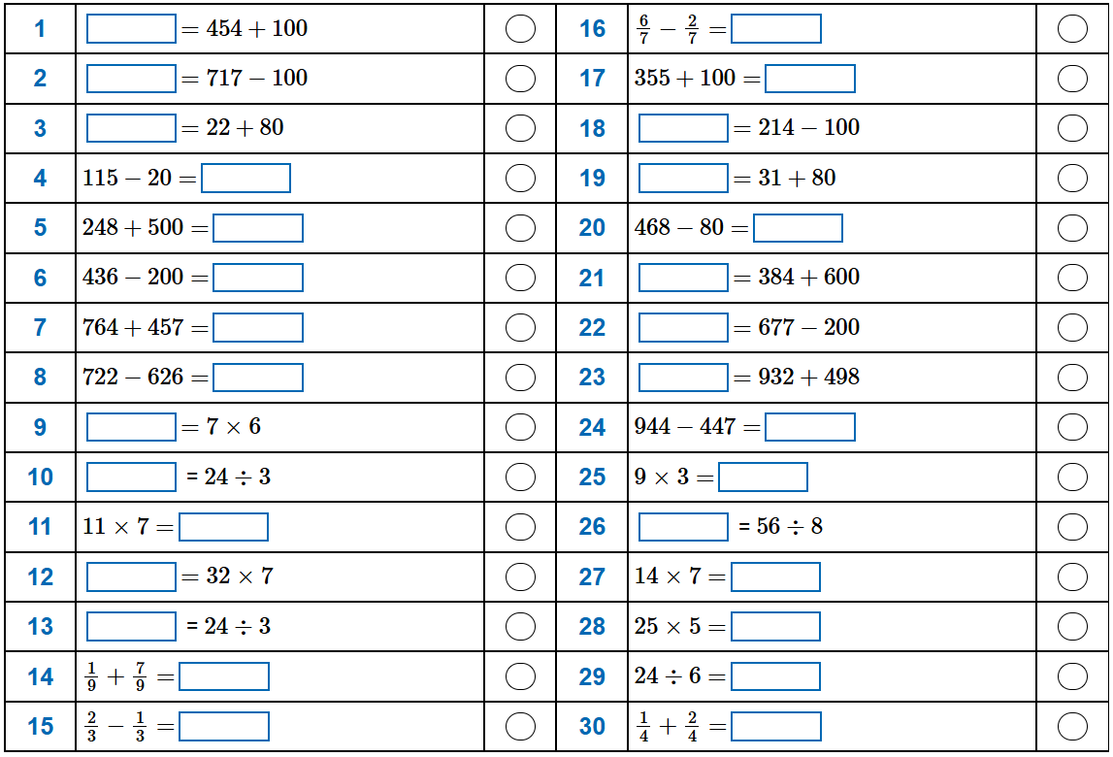
Arithmetic Day 2

Slide 2
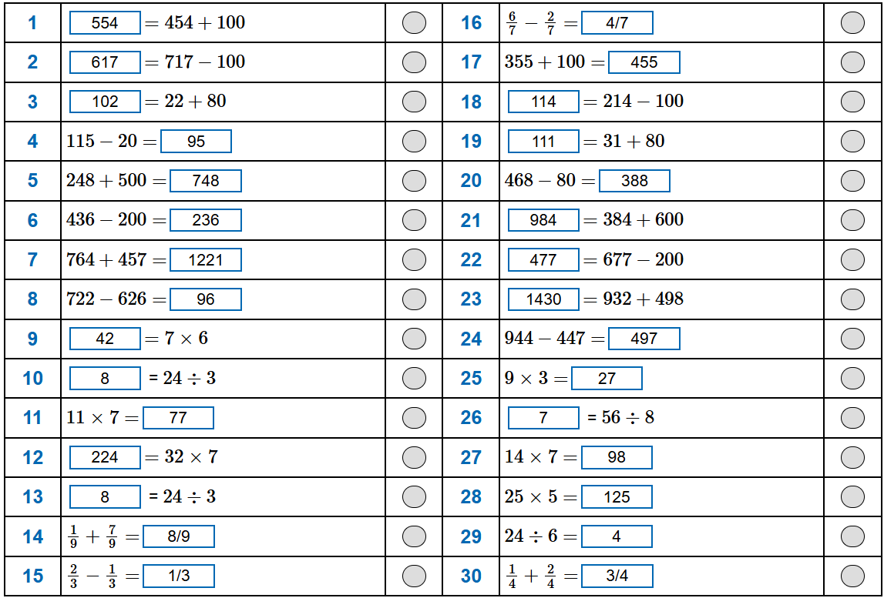
Arithmetic Day 2 - Answers

